Slide 1
Project 1
Random Match Probability (RMP)
Sai Ram Vodnala, Carlos Quevedo, Soniya Shahi, Kevin Osei-Onomah

Slide 2
Introduction
This project evaluates the efficacy of three statistical methods i.i.d. Binomial (UB1), Independent Comparisons Binomial (UB2) and U-Statistic (UB3) for calculating the upper confidence bounds (UCBs) of Random Match Probability (RMP) in biometric systems using Monte carlo simulations.

Slide 3
Random Match Probability
Definition: RMP is the likelihood that two distinct individuals may appear to match in a biometric system purely by chance.
Significance: Calculates the probability of erroneous matches between unrelated individuals based on biometric data.
Importance: A lower RMP indicates a more secure and trustworthy biometric technology.

Slide 4
Upper Confidence Bound
In statistics, a confidence bound, like a 95% confidence interval, indicates a 95% confidence that the true population parameter falls within the interval.
Upper Confidence Bound: In statistical terms, the upper confidence bound represents the upper limit of a previously defined confidence bound, and it signifies the value below which the true population parameter is expected to remain with a specified level of confidence, which is set at, 95%, for our case.
The concept of the confidence interval is very important in statistics (hypothesis testing) since it is used as a measure of uncertainty.
During a statistical computation, 95% of the true values (e.g., mean) will fall within X [lower bound] and Y [upper bound] interval.

Slide 5
Monte Carlo Simulation
Definition: Monte Carlo Simulation is a computational technique involving repeated random sampling to perform a wide range of experiments and obtain numerical results.
We Conducted the Simulations:
To Perform multiple runs of the simulation, each time calculating the RMP using the three different statistical methods.
For each method, determine the upper confidence bound of the RMP and observed how closely these bounds contain the true RMP, from this Monte Carlo simulation setup.

Slide 6
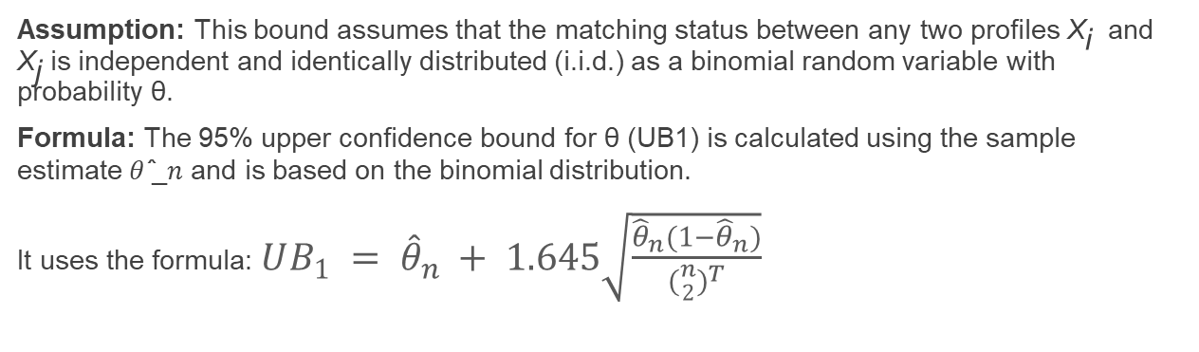
UB1 - i.i.d. Binomial Assumption
Assumption: This bound assumes that the matching status between any two profiles X_{i ​} and X_{j​} is independent and identically distributed (i.i.d.) as a binomial random variable with probability θ.
Formula: The 95% upper confidence bound for θ (UB1) is calculated using the sample estimate 𝜃 ̂_𝑛 and is based on the binomial distribution.
It uses the formula:$UB_{1} = {\hat{θ}}_{n} + 1.645\sqrt{\frac{{\hat{θ}}_{n}(1−{\hat{θ}}_{n})}{{({n \atop 2})}^{T}}}$

Slide 7
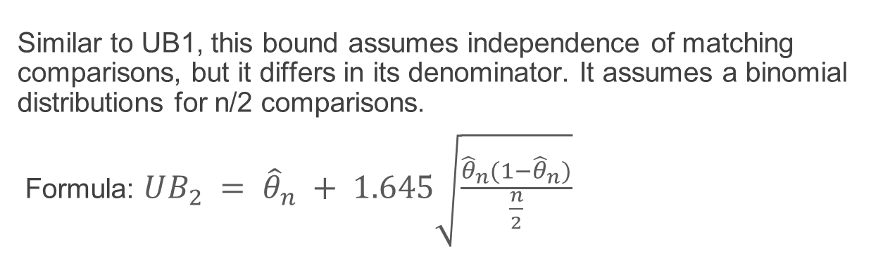
UB2 - Independent Comparisons Binomial Assumption
Similar to UB1, this bound assumes independence of matching comparisons, but it differs in its denominator. It assumes a binomial distributions for n/2 comparisons.
Formula: $UB_{2} = {\hat{θ}}_{n} + 1.645\sqrt{\frac{{\hat{θ}}_{n}(1−{\hat{θ}}_{n})}{\frac{n}{2}}}$

Slide 8
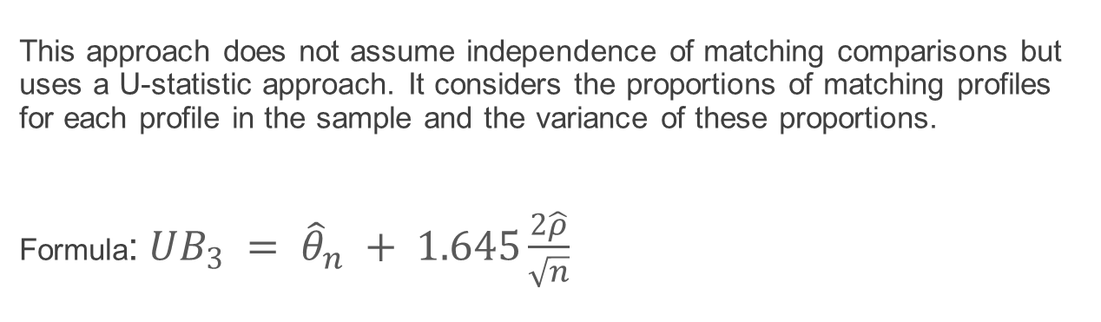
UB3 - A U-Statistic Approach
This approach does not assume independence of matching comparisons but uses a U-statistic approach. It considers the proportions of matching profiles for each profile in the sample and the variance of these proportions.
Formula:$UB_{3} = {\hat{θ}}_{n} + 1.645\frac{2\hat{ρ}}{\sqrt{n}}$

Slide 9
Case 1:In the first scenario we assign equal probabilities (i.e 1/C) for each category out of 'C' categories using the below rmultinom()It ensures that the population exhibits an identical distribution of probabilities for matching in every possible pair. Thus every category is equally likely to be represented in the population.
Case 2: In case 2, we modify the probabilities assigned to each category by assigning unequal probabilities to them using the below rmultinom().Thus they no longer exhibit an identical distribution of probabilities for each possible pair.

Slide 10
Philosophy of Statistical Averaging for Robust Estimation and Coverage
Statistical Averaging for a Reliable Estimation:
Concept: Mean of theta.hat is employed to enhance the estimation of the random match probability (RMP).
Rationale: In a simulated environment, theta.hat represents a series of sample estimates, and the mean across iterations provides a stable RMP estimate.
Coverage Analysis Philosophy:
Process: Evaluates reliability of upper confidence bounds (e.g., ub1) through a consistent and iterative approach.
Metric: Coverage probability quantifies how accurately upper bounds encapsulate the true RMP across multiple simulations.
Importance: Ensures precision in statistical estimates and the accuracy of intervals for the population parameter.

Slide 11
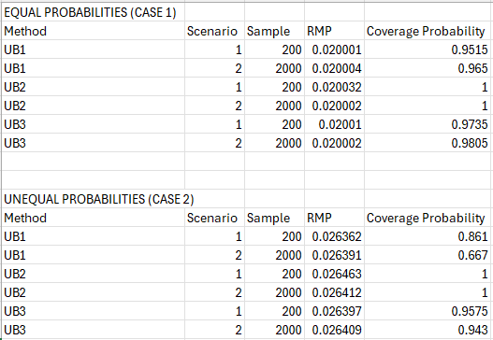
RESULTS
𝑈𝐵3 : It provides a good balance between 95% coverage and upper bound size with low RMP Estimate. So, we recommend UB3 approach.

Slide 12
Motivation behind combination of sample & simulation sizes
We may investigate how the precision and accuracy of our estimations alter as the amount of data increases by varying the sample and simulation sizes.
We conducted simulations using sample sizes ranging from 15 to 3000. and maintained a consistent simulation size of 2000.
This decision was made with computational efficiency in mind, as a fixed simulation size helped manage computational time constraints

Slide 13
Strengths of Multinoullis
Simple to explain/understand
Simple to implement
Probabilities of categories needed

Slide 14
Weaknessess of Multinoullis
Resource-demanding
Data Complexity
Dependencies of outcomes

Slide 15
Recommendations
From the results of the simulations we recommend UB3, Independent Comparisons Binomial Assumption, which had the lowest upper bound but still within the 95% confidence interval.

Slide 16
References
Ahmed, I. (2021, August). Confidence Intervals and How to Find Them. Medium. URL: https://medium.c om/@ibtesamahmex/confidence-intervals-and-how-to-find-them-42fe4e0900c3
CFI Team. Monte Carlo Simulation. Corporate Finance Institute. URL:https://corporatefinanceinstitute.com/resources/knowledge/modeling/monte-carlo-simulation/
CFI Team. Confidence Interval. Corporate Finance Institute. URL:https://corporatefinanceinstitute.com/resources/data-science/confidence-interval/
Monte Carlo Method. Wikipedia. https://en.wikipedia.org/wiki/Monte_Carlo_method
multinom. (n.d.). RDocumentation. https://www.rdocumentation.org/packages/nnet/versions/7.3-19/topics/multinom

Slide 17
Thank you!

